Slide 1

SAFETY ISSUES
OHSAA has always played key role in developing polices covering all aspects of safety for student- athletes
Weather, Concussion Management, and Equipment are just three of these that we will touch on at various times today
Safety is an important responsibility for all involved

Slide 2

INCLEMENT WEATHER
STOP CONTEST
MANDATORY
ANY SIGN OF EITHER LIGHTNING OR THUNDER
GO TO SAFE LOCATION
30 MINUTE MINIMUM WAIT
RESUME AT LATER DATE – IF NEEDED
Notes:
Please refer to your Preseason Manual for the precise language regarding Lightning and Inclement Weather. Competition or practice shall be suspended once lightning has been recognized or thunder heard. It is Mandatory to wait at least minutes after the last flash of lightning is witnesses or thunder is heard prior to resuming practice or competition.

Slide 3
Thirty Minute Rule
Competition or practice shall be suspended once lightning has been recognized or thunder is heard. It is mandatory to wait at least 30 minutes after the last flash of lightning is witnessed or thunder is heard prior to resuming practice or competition. Any subsequent lightning or thunder after the beginning of the 30-minute count shall reset the clock, and another count shall begin.

Slide 4
INCLEMENT WEATHER
If lightning is imminent or a thunderstorm is approaching, all personnel, athletes and
spectators shall evacuate to available safe structures or shelters.

Slide 5
INCLEMENT WEATHER
REVIEW PRESEASON GUIDE AND SOFTBALL MANUAL FOR WEATHER-RELATED INFORMATION
THESE RULES MUST BE ENFORCED BY ALL!

Slide 6
Pregame Equipment Checks
No longer done under NFHS Rules
Coach must verify players legally equipped
Umpires must remain vigilant – equipment issues are not an appeal play
Bats
Catcher’s Helmet/Mask
Batter/Runner Helmets Face Mask
Jewelry
Penalties

Slide 7
Pregame Field Inspection
Needs to be done each game
Know what you are looking for
Remove hazards
Report what can’t be fixed on the spot
Athletic Administrator needs to know
Understand ground rules and issues

Slide 8
CONCUSSION MANAGEMENT
OHSAA has always played key role in developing polices covering all aspects of safety for student- athletes
Ohio law which became effective middle of 2013 season included many OHSAA regulations and added several aspects to previous regulations

Slide 9
CONCUSSION MANAGEMENT
State law regulates some aspects
Return to play has been updated
Contest officials and others are now required to have completed an approved training program in concussion recognition
Other portions of the law impact schools, coaches, parents and student athlete participants

Slide 10
CONTEST OFFICIALS REQUIREMENTS
The new legislation provides that no school “shall permit” an individual to referee interscholastic athletic contests unless the individual holds a Pupil Activity Program/Coaching Permit or has successfully completed within the last three years a training program in concussion recognition. Therefore, all OHSAA licensed officials shall possess either a current Department of Education issued Pupil Activity Program/Coaching Permit or show evidence of completing an approved online concussion education course as stipulated by the law.

Slide 11
CONCUSSION MANAGEMENT
This OHSAA regulation, as amended to incorporate this recent legislation, now reads: Any student, while practicing for or competing in an interscholastic contest, who exhibits signs, symptoms or behaviors consistent with having sustained a concussion or head injury (such as loss of consciousness, headache, dizziness, confusion or balance problems) shall be immediately removed from the practice or contest by either of the following: 1) The individual who is serving as the student’s coach during that practice or competition OR 2) An individual who is serving as a contest official or referee during that practice or competition.
Notes:
Comments: Concussion Management – The position of the NFHS Sports Medicine Advisory Committee is that no athlete shall return to play or practice on that same day after suffering a concussion. Studies have shown medical professionals that the school-aged brain does not recover quickly enough for a high school athlete to return to activity in such a short time. No athlete should return-to-sport or other at-risk participation when symptoms of concussion are present and recovery is ongoing. Please see the “NFHS Suggested Guidelines for Management of Concussion” at www.nfhs.org for further information.

Slide 12
RETURN TO PLAY PROTOCOL
If a student is removed from practice or competition due to a suspected concussion or head injury, the coach or referee who removes the student shall not permit the student, ON THE SAME DAY THE STUDENT IS REMOVED, to return to that practice or competition or to participate in any other practice or competition for which the coach or contest official is responsible.

Slide 13
RETURN TO PLAY PROTOCOL
The student athlete can return on a subsequent day after the student’s condition has been assessed by an authorized health care provider and the student receives written authorization from the provider stating that it is safe to return to practice or competion.

Slide 14
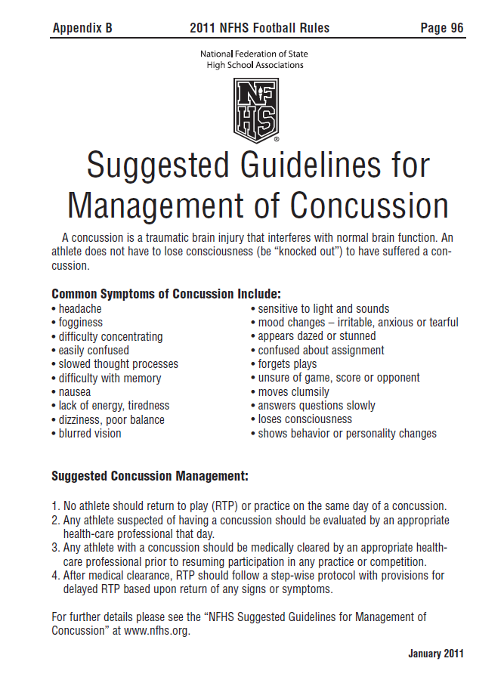
CONCUSSION MANAGEMENT
Remains in ALL NFHS Rules Books
Page 88 of 2014 NFHS Softball Rules
List of Common Symptoms of Concussion
Other information on this page does not reflect Ohio law or OHSAA regulations
Under current Ohio Law officials are no longer involved in handling Medical Authorization to Return to Play Documents. This is now a school responsibility.
Notes:
Comments: A new form has been developed to document when a player, who has been removed due to exhibiting signs, symptoms or behaviors consistent with concussion, has been approved to return to play that day. The form can be found on the OHSAA web site at www.ohsaa.org on both the sports medicine link and the Volleyball page. Officials who have removed a player under this rule shall not permit the player to return to play without this signed form. The official should then make a copy of the form and forward it to the OHSAA office.

Slide 15
CONCUSSION MANAGEMENT
What does this mean to Coaches & Officials?
Coaches and/or Officials are NOT expected to “diagnose” a concussion that is the job of an appropriate health-care professional.
Coaches, Officials AND Administrators ARE all responsible to make all efforts to ensure that concussed athletes do not continue to participate.
Notes:
Neither officials, nor coaches, are expected to DIAGNOSE a concussion; that is the job of an appropriate health-care professional. The previous rule called upon officials to determine “apparently unconscious” which appeared to expect some level of medical judgment. Officials are now being asked to use their best judgment again in observing the signs, symptoms and behaviors, but are no longer being asked to make what could be perceived to be a medical opinion. The well-being of the athlete is of paramount concern during any athletic contest. Officials, coaches and administrators are being asked to make all efforts to ensure that concussed athletes do not continue to participate. Early recognition of concussion and removal of the injured athlete from activity (game or practice) is a shared responsibility. Thus, coaches, players and administrators should also be looking for signs of concussion in all athletes and should immediately remove any suspected concussed athlete from play.

Slide 16
Concussion Recognition and
Management Procedures
The Official is NOT RESPONSIBLE for the evaluation or management of the athlete after she is removed from play.
This responsibility rests with school personnel and of course medical professionals
Notes:
Neither officials, nor coaches, are expected to DIAGNOSE a concussion; that is the job of an appropriate health-care professional. The previous rule called upon officials to determine “apparently unconscious” which appeared to expect some level of medical judgment. Officials are now being asked to use their best judgment again in observing the signs, symptoms and behaviors, but are no longer being asked to make what could be perceived to be a medical opinion. The well-being of the athlete is of paramount concern during any athletic contest. Officials, coaches and administrators are being asked to make all efforts to ensure that concussed athletes do not continue to participate. Early recognition of concussion and removal of the injured athlete from activity (game or practice) is a shared responsibility. Thus, coaches, players and administrators should also be looking for signs of concussion in all athletes and should immediately remove any suspected concussed athlete from play.

Slide 17
Concussion Recognition and
Management Procedures
No coach or official may permit a removed player to return to competition or practice on the same day the student is removed due to a suspected concussion or head injury.
Notes:
However....and this is they key; ONLY an “appropriate health-care professional” may make the determination that a player may return to play. Ohio has recognized ONLY MDs, DOs and LICENSED athletic trainers as the ONLY ones permitted to grant this return to play.
This approval MUST BE IN WRITING using the OHSAA Return to Play Form!
The COACH CANNOT re-insert a player after being removed by an official WITHOUT a written approval from an M.D., a D.O., or a Licensed Athletic Trainer.
Schools are encouraged to develop a protocol regarding this. It may be common for a team physician to be present at a VARSITY/JV Contest....but not at a freshmen or Junior High game. Schools should address this to answer the question of whether or not a parent, who might be a physician has the right to come out of the stands and provide written approval to return to play when the physician may not be the schools’ Board adopted Team Physician. WHEN IN DOUBT...SIT ‘EM OUT!

Slide 18
CONCUSSION FORMS
Found at www.ohsaa.org – Sports Medicine and Softball
TWO IMPORTANT FORMS
OHSAA CONCUSSION REPORT – Send to Brandy Young - OHSAA office.
MEDICAL AUTHORIZATION TO RETURN TO PLAY – Not used by officials at this time.
Notes:
A copy of all concussion forms can be found on the OHSAA web site on the Softball
Page and on the Sports Medicine Page
The form to use when a student has been sent out due to an official’s recognition of the signs and symptoms of a possible concussion to authorize RTP by an MD, DO or AT is found here on both the sports medicine and softball pages. It is entitled “Documentation of a Removal from Play for Concussion Management”
The form that the official must file when a student has been removed for signs of a concussion and has not been returned to play is also found here at both sites and is entitled: Medical Authorization to Return to Play- Not Concussed”
Note that the official should keep a copy of both forms for his/her records and send the original to the OHSAA.

Slide 19
CONCUSSION MANAGEMENT
If a contest official is aware that a student has been permitted to return to competition on the same day as removal, that official shall immediately stop play and remove that student from competition and report the incident to the OHSAA.

Slide 20
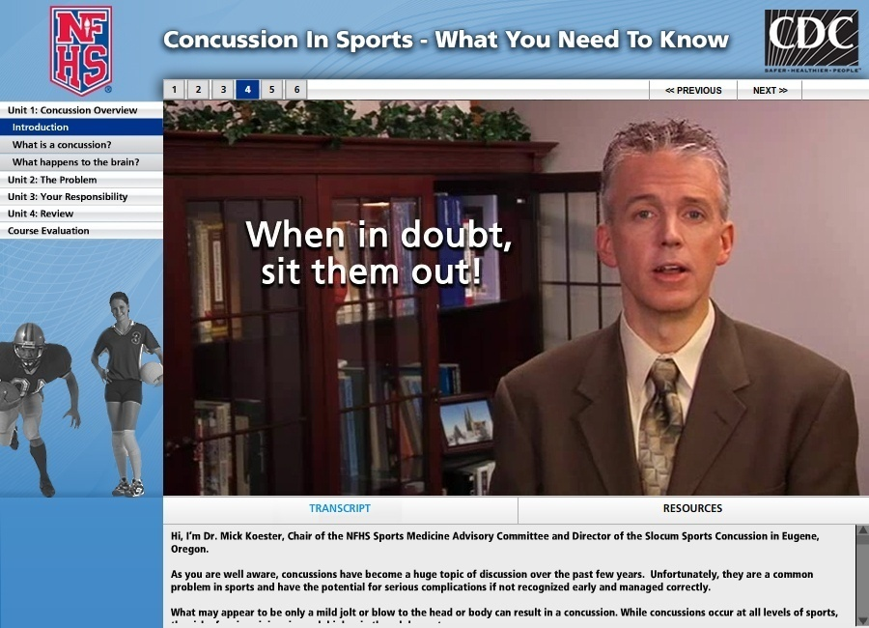
Concussion in Sports www.nfhslearn.com
Notes:
To assist in concussion management education, the NFHS, at no cost, offers Concussion in Sports - What You Need to Know.
The only requirement is registering on www.nfhslearn.com, which is quick and easy.
This 20 minute course is designed for coaches, officials, parents, administrators and students to learn how to recognize the signs and symptoms of concussions and a step-wise process to return to the sport.
Check it out and share this information with others. Approximately 155,000 courses have already been delivered!

