Slide 1

OHSAA Softball Meetings 2018
Mechanics

Slide 2
OHSAA Softball Mechanics –
Why the emphasis?
Use of NFHS – Standard Mechanics
Solid, Sound Reasoning
Easy to understand
Many Areas/Associations did their own thing
Countless deviations
Need for uniformity & consistency statewide
Put umpires in the best place for call
Improve communication
Promote “Crewness”
Preplanned deviations are unacceptable
Goal is to get plays right and communicate

Slide 3
Mechanics
Three Keys to Good Judgment
Position – Angle, Distance, Unobstructed View are the keys
Stationary – Stop/Set/See Play/Make Call
Timing
These must be worked on every game, all season long as well as in preseason training
With more training being offered we have a higher level of expectation for our umpires

Slide 4
Plate
Mechanics

Slide 5
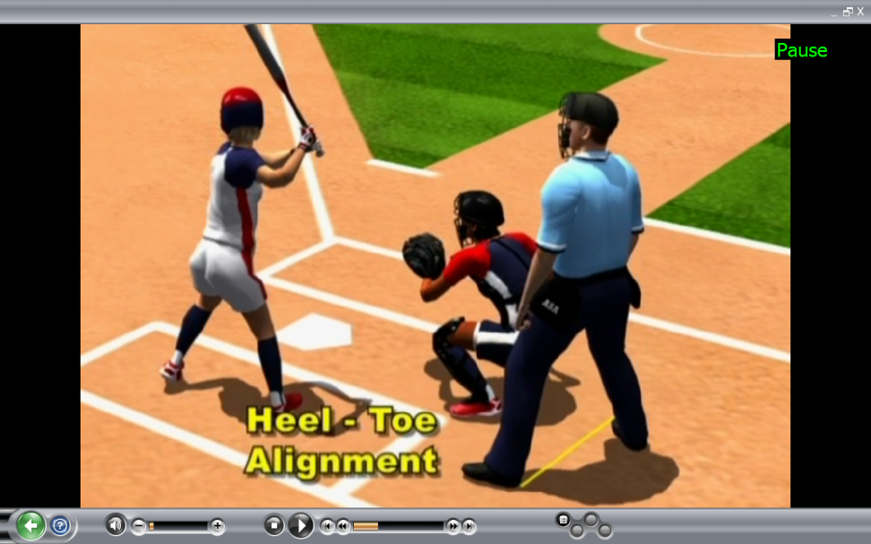
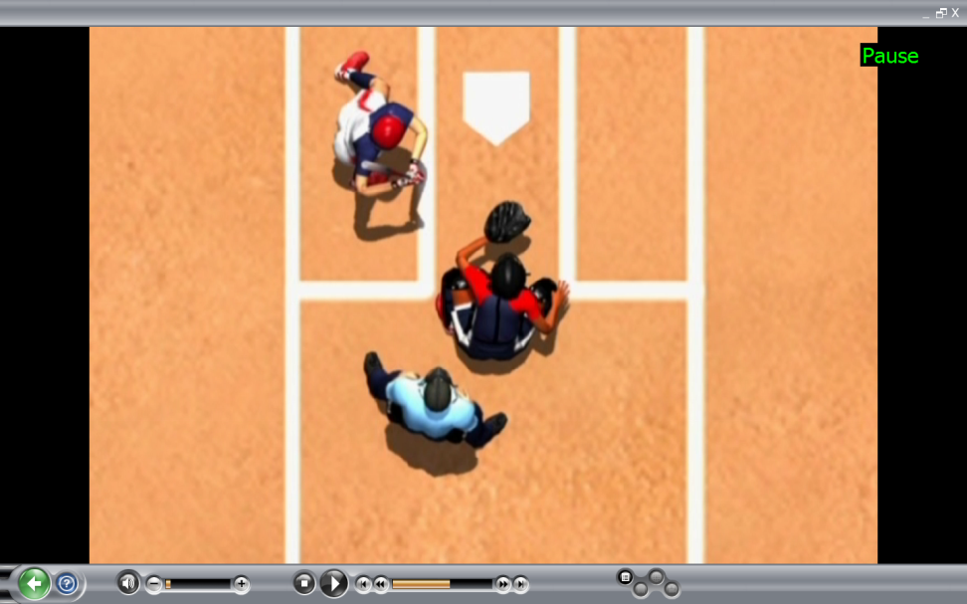
STANCE
Heal-Toe setup
Proper step in
Set Feet
Square to Plate
Distance from Catcher
Notes:
Step in with foot closest to catcher 1st.
Check shoulders to be sure they are square to plate.

Slide 6
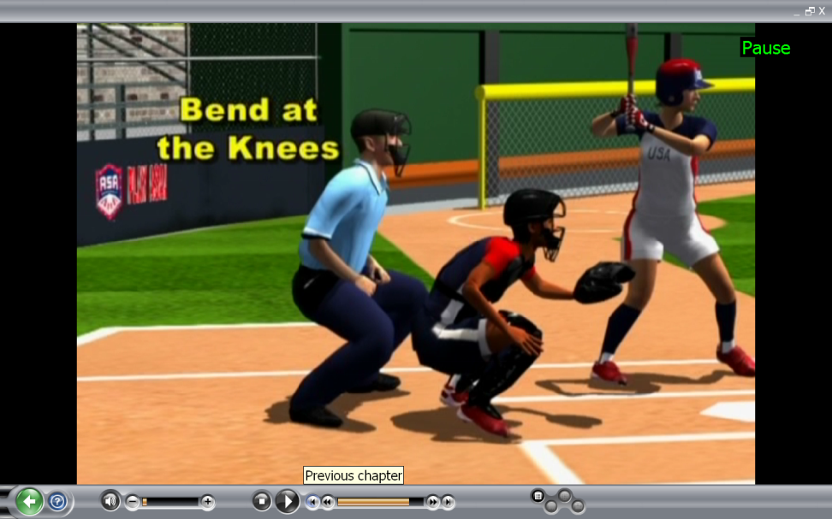
STANCE
Bend at knees not at waist
Knees over toes
Slight Tilt Forward
Rotate Head / Eyes to pitcher

Slide 7
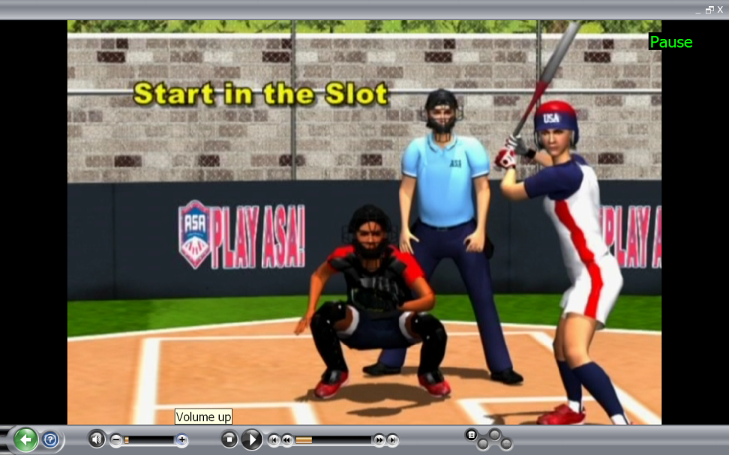
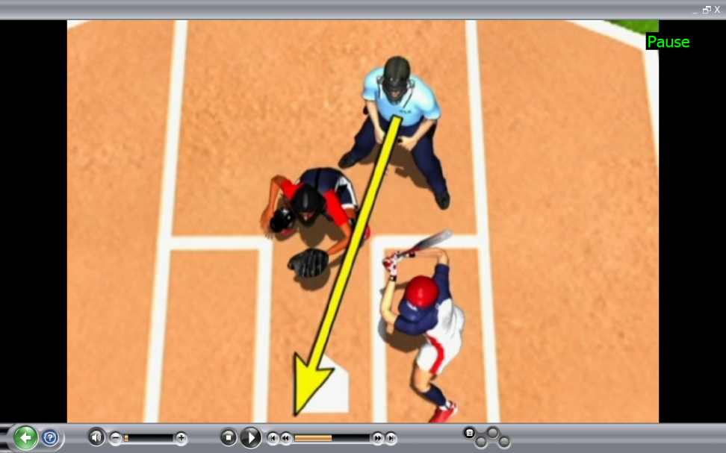
SET POSITION
Start in slot
Go to just inside the inside edge of plate
Remain out of the perimeter of strike zone
GPA = Good Pelvic Alignment
Open to outside pitch
Allows you to track the pitch to glove

Slide 8
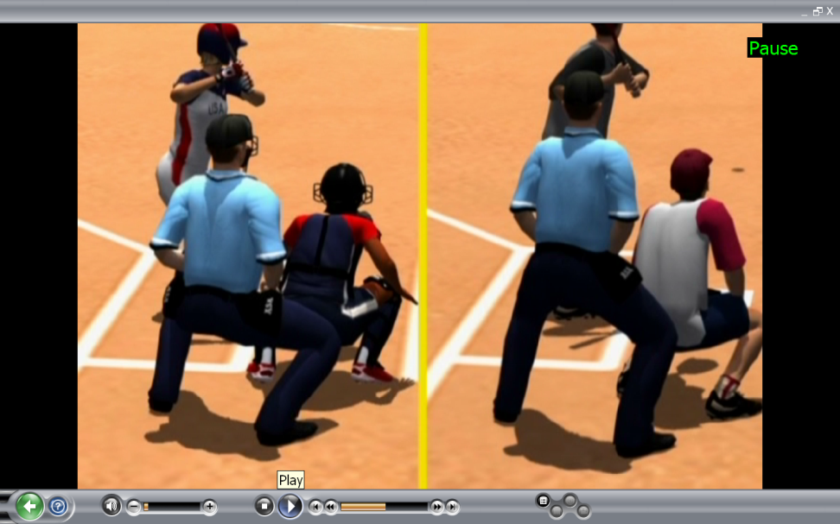
SET POSITION
Top of zone
Hand placement
Timing
Don’t go down too late
Notes:
When to get set

Slide 9
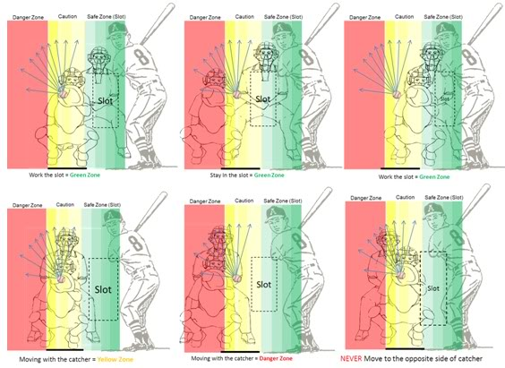
Working the Slot
Don’t move with catcher

Slide 10
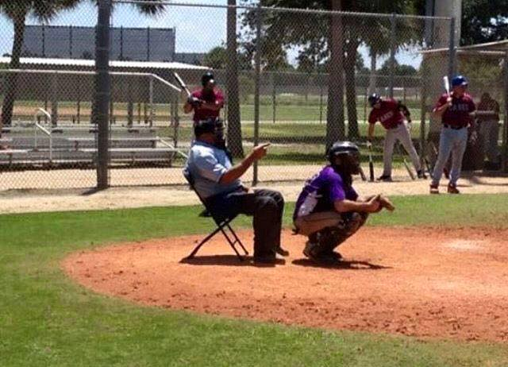
What’s wrong with this picture?
Not using heal-toe setup!

Slide 11
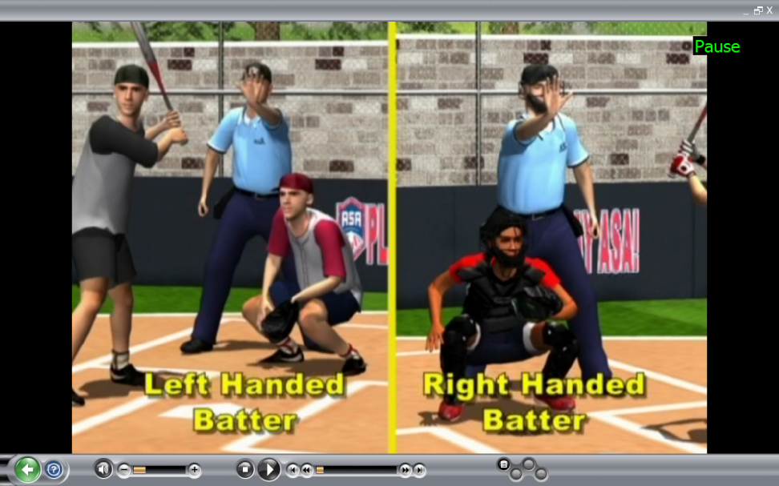
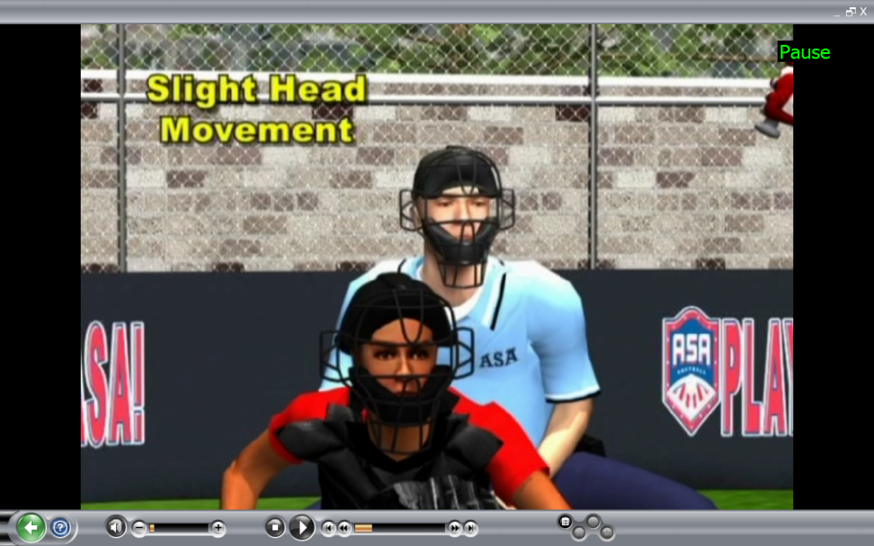
THE PITCH
Prior to – hold up play
Proper hand
Frequency
Tracking – pitcher’s hand - catcher’s glove
Slight movement ONLY, guided by nose
Strike / Ball Call
Called 3rd strike
Notes:
No Leaning, Stay Down
Voice on Balls/Strikes – Proper Signals
Timing
Sell the K
Swinging K

Slide 12
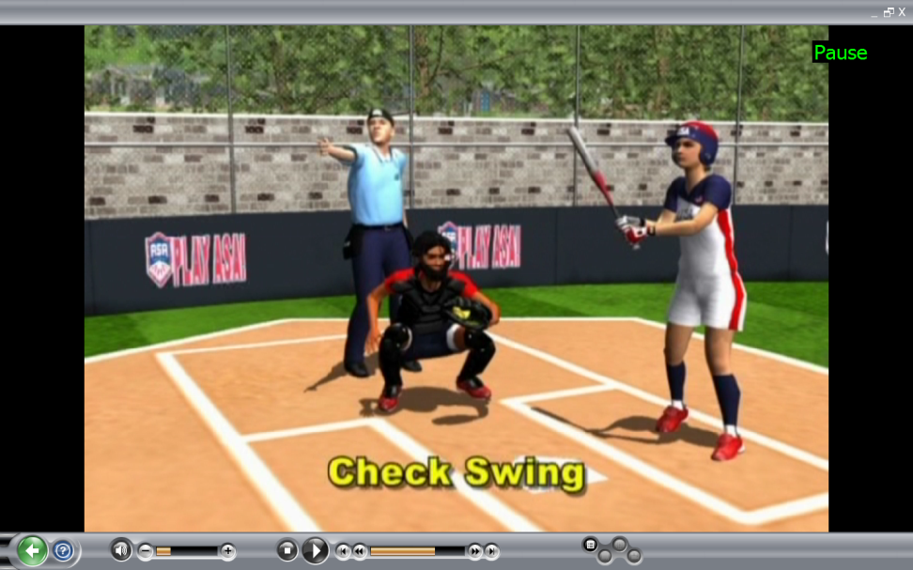
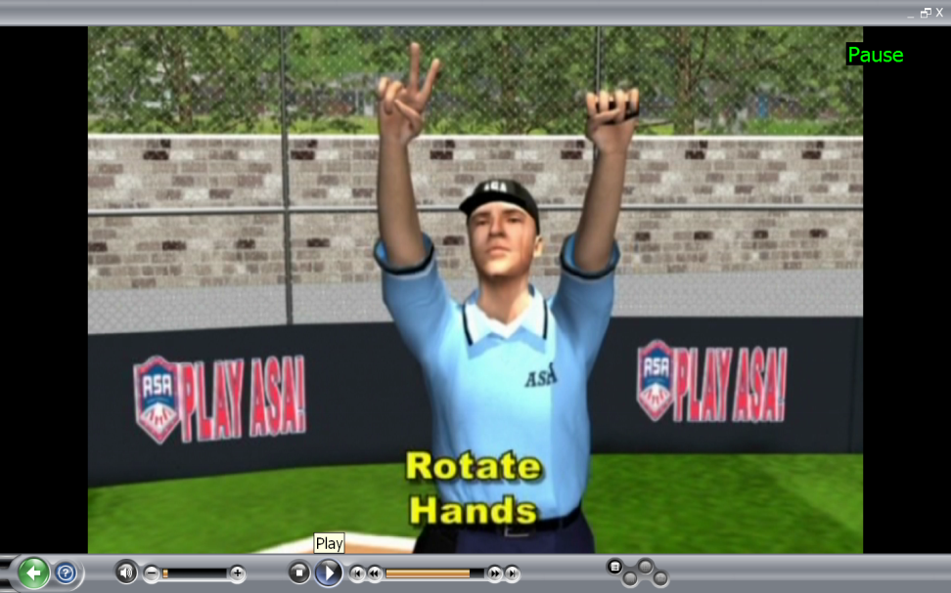
THE PITCH
Check Swing – Partner & Count
Giving the count
Rotation
When
To whom

Slide 13
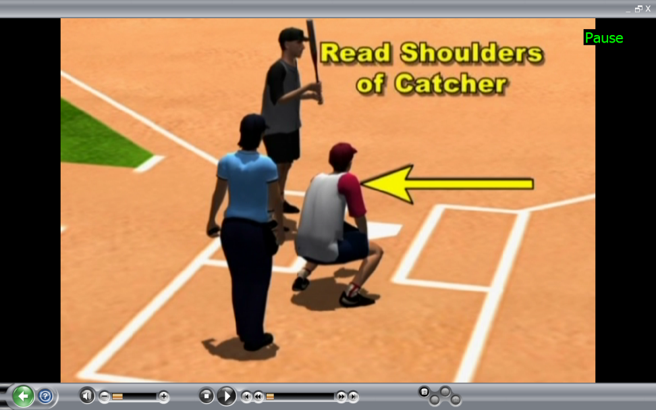
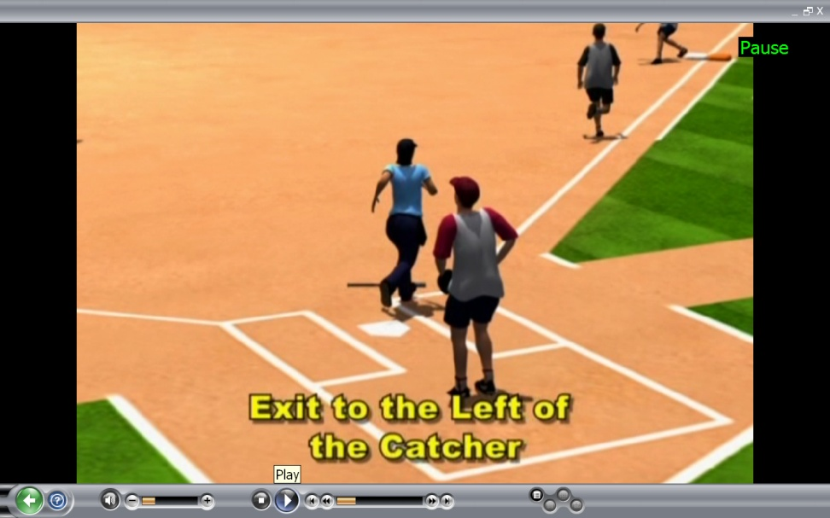
MOVEMENT
Clear Catcher
Read Shoulders
Pivot / Drop step
Trailing
  When
  Where
  Stay close to foul line

Slide 14
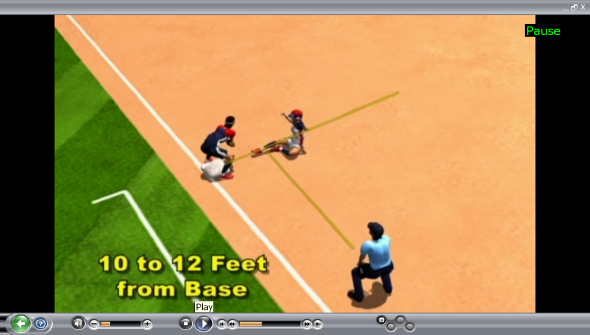
MOVEMENT
Runner on 1B only
  Trail - Release
  Priorities
  Inside diamond to 3B
No Runners
  Trail to Holding Zone

Slide 15
MOVEMENT TO 3B
Play at 3B – Directly into fair ground
Movement to Holding Zone – Read – Come Inside

Slide 16
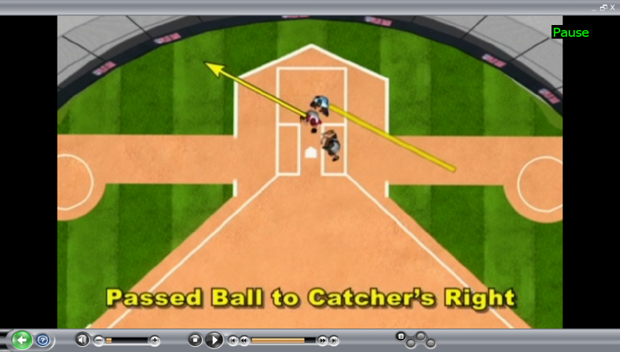
MOVEMENT TO 3B
Steal of 3B
  Passed ball to catcher’s right
  Passed ball to catcher’s left

Slide 17
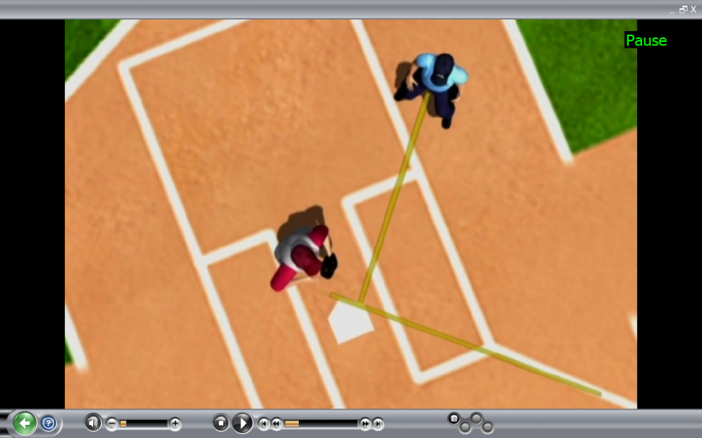
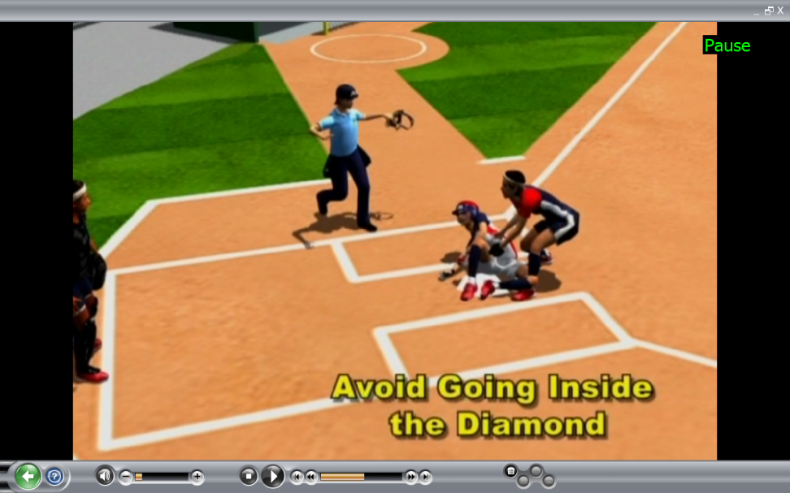
PLAYS AT THE PLATE
Starting Position
Where to be
How to adjust
Passed Ball
  Find the Ball
  Adjust appropriately

Slide 18
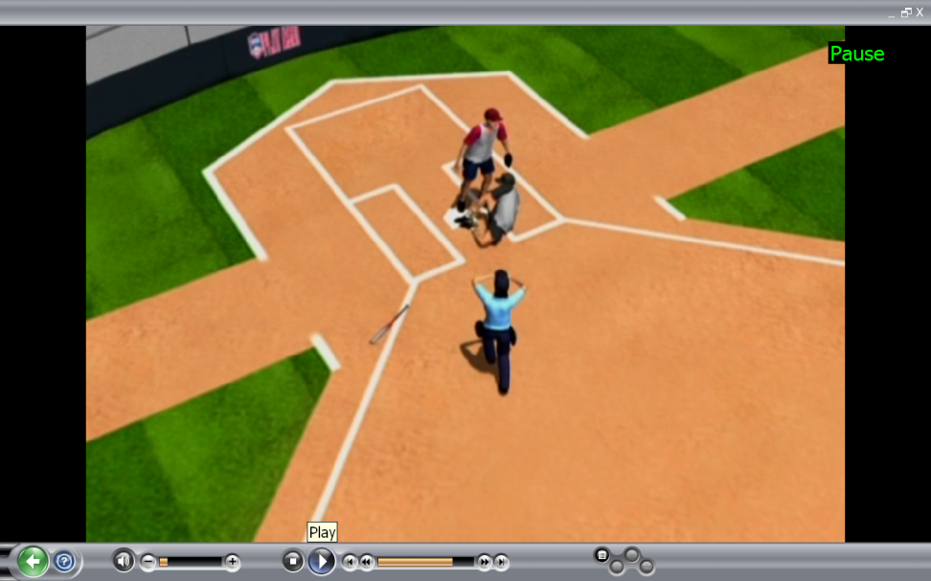
PLAYS AT THE PLATE
Plays at 3B – then the plate
  Stay inside the diamond
  Stay ahead and parallel
  Get unobstructed view

Slide 19
Review Items – Movement from Plate
Remove Mask
Unnecessary Foul Calls
Trail the B/R
Fair/Foul Positioning and Mechanics – Straddle Line and Priorities
Use of Holding Zone
Proper Position – Plays at 3B and Plate
Movement on Foul Flies
When partner out cover bases and don’t echo partner

Slide 20
THE EPILOG
Stance
Set Position
Tracking
Timing
Movement
=
GOOD PLATE MECHANICS

Slide 21
Base
Mechanics

Slide 22
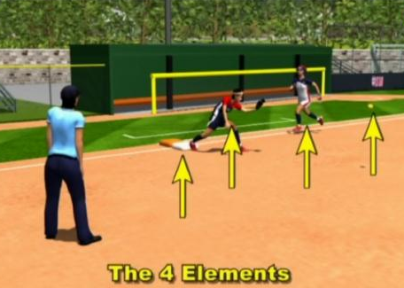
BASE MECHANICS
A COMPREHENSIVE LOOK AT MOVEMENT AND ANGLES TO CREATE AN UNOBSTRUCTED VIEW OF:

Slide 23
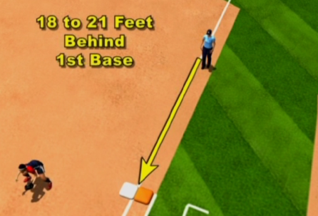
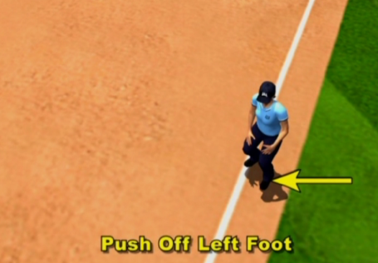
STARTING POSITION NO RUNNERS
Just off the line in foul ground
Walking the line
The purpose
Notes:
Square up to plate
Watch pitcher
See Pitcher, Plate, Runner(s)
Observe/Call Illegal Pitch

Slide 24
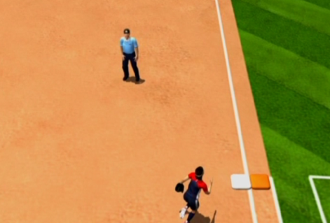
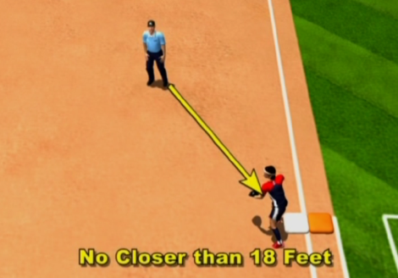
TAGS…FORCES…PLAYS AT 1B
Angle you establish
No further than 45⁰
Watch the fielder fielding the ball
Maintain proper distance
Let ball take you to play
Square to play
Stop, see the play, then make the call
Notes:
Force Plays vs. Tag Plays – Leading Edge

Slide 25
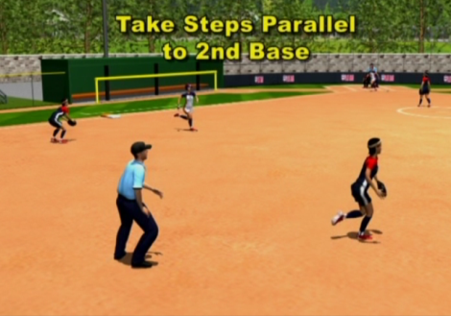
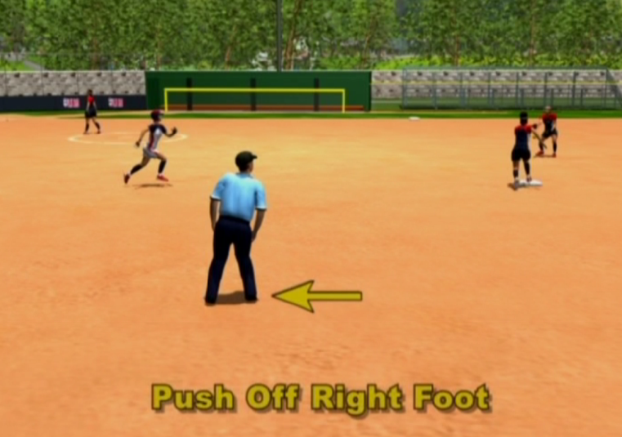
TAGS…FORCES…PLAYS AT 1B
Double Play
Steps toward 2B…why
Eyes on the ball
Then…
…Push off with your right foot
Make out call at 2B while moving toward 1B
Then…

Slide 26
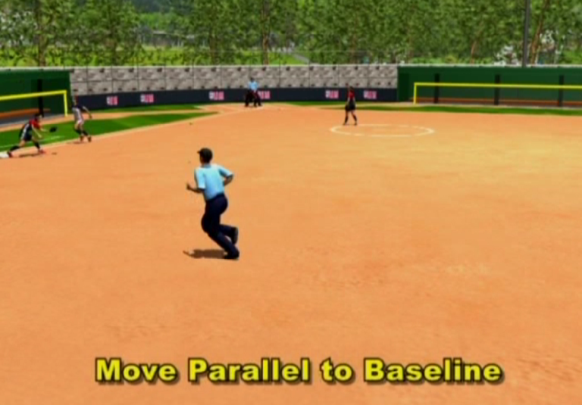
TAGS…FORCES…PLAYS AT 1B
Continue moving parallel toward1B, letting the “ball” turn your head
Square up to the play and stop
See the play
Make the call
Sell close plays

Slide 27
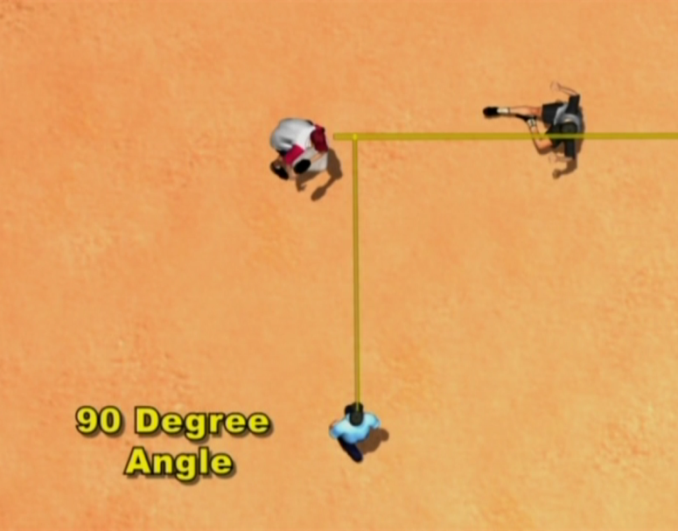
TAGS…FORCES…PLAYS AT 1B
Tag Plays
Repeat after me….
90 degrees to the path of the runner
Just short of the base they are trying to reach
Stop, see the play, make the call

Slide 28
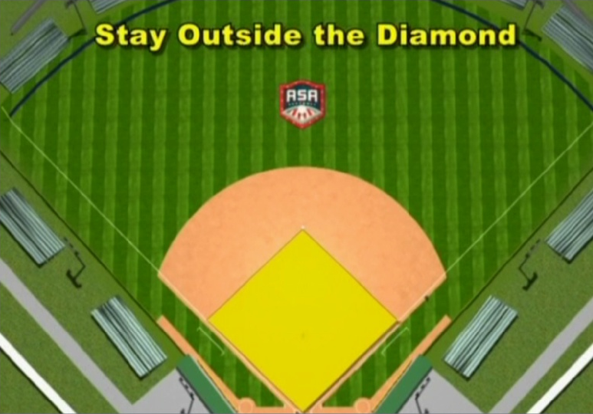
INSIDE/OUTSIDE MOVEMENT
Ball hit inside the infield
Stay outside the diamond

Slide 29


PARALLEL MOVEMENT OUTSIDE DIAMOND
Notes:
PARALLEL MOVEMENT OUTSIDE THE DIAMOND
DOUBLE PLAY
FORCE OUT
TAG PLAY
PICKOFF
PARALLEL MOVEMENT PROVIDES AN UNOBSTRUCTED VIEW OF THE PLAY
PROPER ANGLE AND DISTANCE

Slide 30
PARALLEL MOVEMENT OUTSIDE DIAMOND
Notes:
FROM THE SHORTSTOP SIDE OF THE DIAMOND
SAME PRINCIPALS APPLY
PARALLEL MOVEMENT PROVIDES AN UNOBSTRUCTED VIEW OF THE PLAY
PROPER ANGLE AND DISTANCE

Slide 31
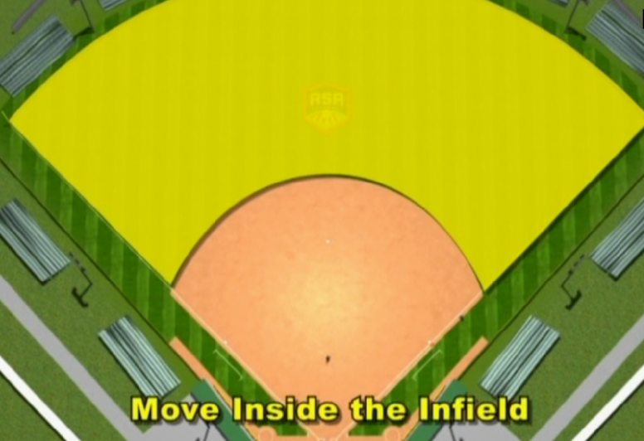
INSIDE/OUTSIDE MOVEMENT
Ball hit outside infield
Determine if need to go out
Move inside the infield

Slide 32

PARALLEL MOVEMENT INSIDE DIAMOND
Notes:
FROM THE INSIDE POSITION AFTER OUR PROPER BUTTONHOOK
OUR PARALLEL MOVEMENT IS THE SAME
PARALLEL MOVEMENT TO THE BASELINE
PARALLEL MOVEMENT PROVIDES AN UNOBSTRUCTED VIEW OF THE PLAY & PROPER ANGLE AND DISTANCE

Slide 33
PARALLEL MOVEMENT INSIDE DIAMOND
Notes:
FROM THE SHORTSTOP SIDE OF THE DIAMOND
SAME PRINCIPALS APPLY
FROM THE INSIDE POSITION AFTER OUR PROPER BUTTONHOOK
OUR PARALLEL MOVEMENT IS THE SAME
PARALLEL MOVEMENT TO THE BASELINE
PARALLEL MOVEMENT PROVIDES AN UNOBSTRUCTED VIEW OF THE PLAY & PROPER ANGLE AND DISTANCE

Slide 34
PARALLEL MOVEMENT REVIEW
THE umpire should:
  “eye on the ball” & “GLANCE AT RUNNER”
  alternate looks – know location of both
  move parallel to baseline
  obtain proper ANGLE & DISTANCE
  “Stop, read the play, make the call”
Notes:
Stop/Set/See/Call – Stationary/Timing

Slide 35
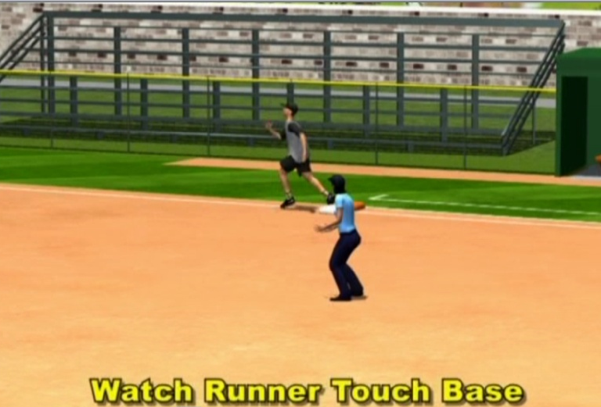
INSIDE/OUTSIDE MOVEMENT
The key is “The Button Hook”
When to use it
Where to go
Movement after the pivot achieves…
Proper viewing of the 4 elements
Notes:
Tighten Buttonhooks

Slide 36
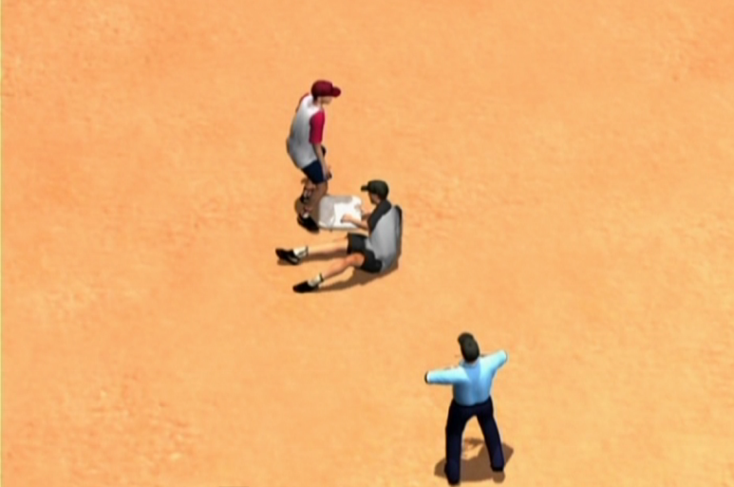
ADJUST FROM PRIMARY POSITION
Tag Plays
When you adjust
Reason to adjust

Slide 37
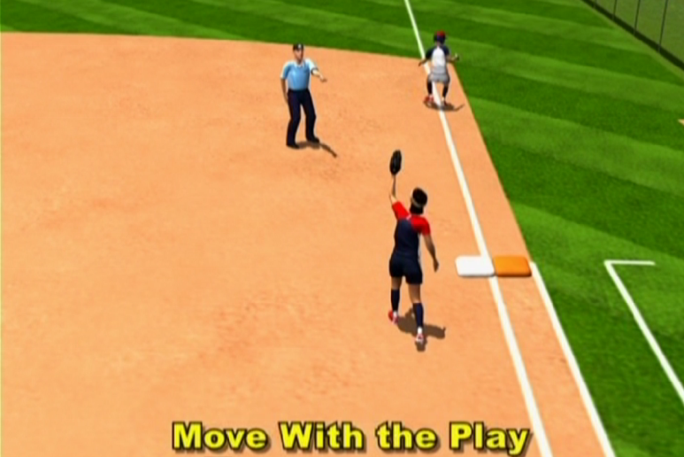
ADJUST FROM PRIMARY POSITION
  Unusual Plays – Swipe tag…Pulled foot
  Philosophy
    Find the ball
    See the runner
    Obtain an unobstructed view of the play
    Stop, see the play, make the call
    Use of the Point

Slide 38
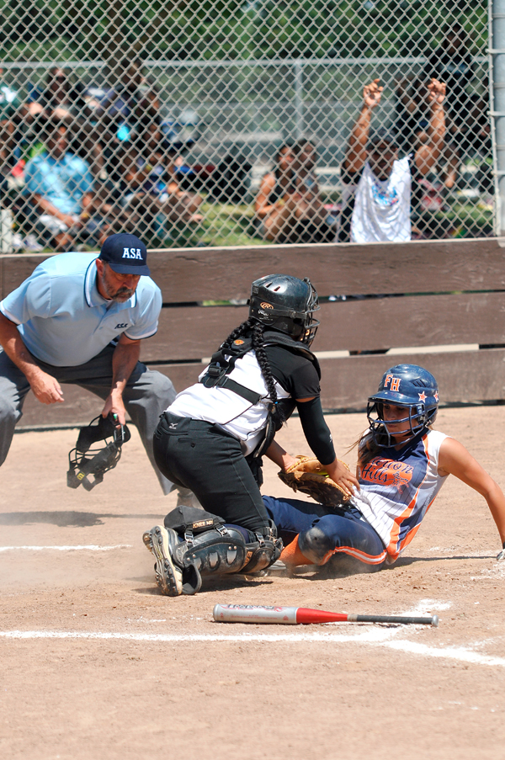
Stop, Read the Play,
GET AN UNOBSTRUCTED VIEW
Make the Call
Can a picture
tell a story?

Slide 39
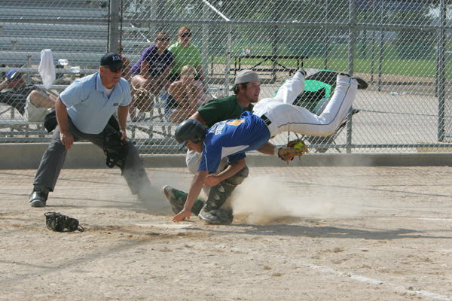
Stop, Read the Play,
GET AN UNOBSTRUCTED VIEW
Make the Call

Slide 40
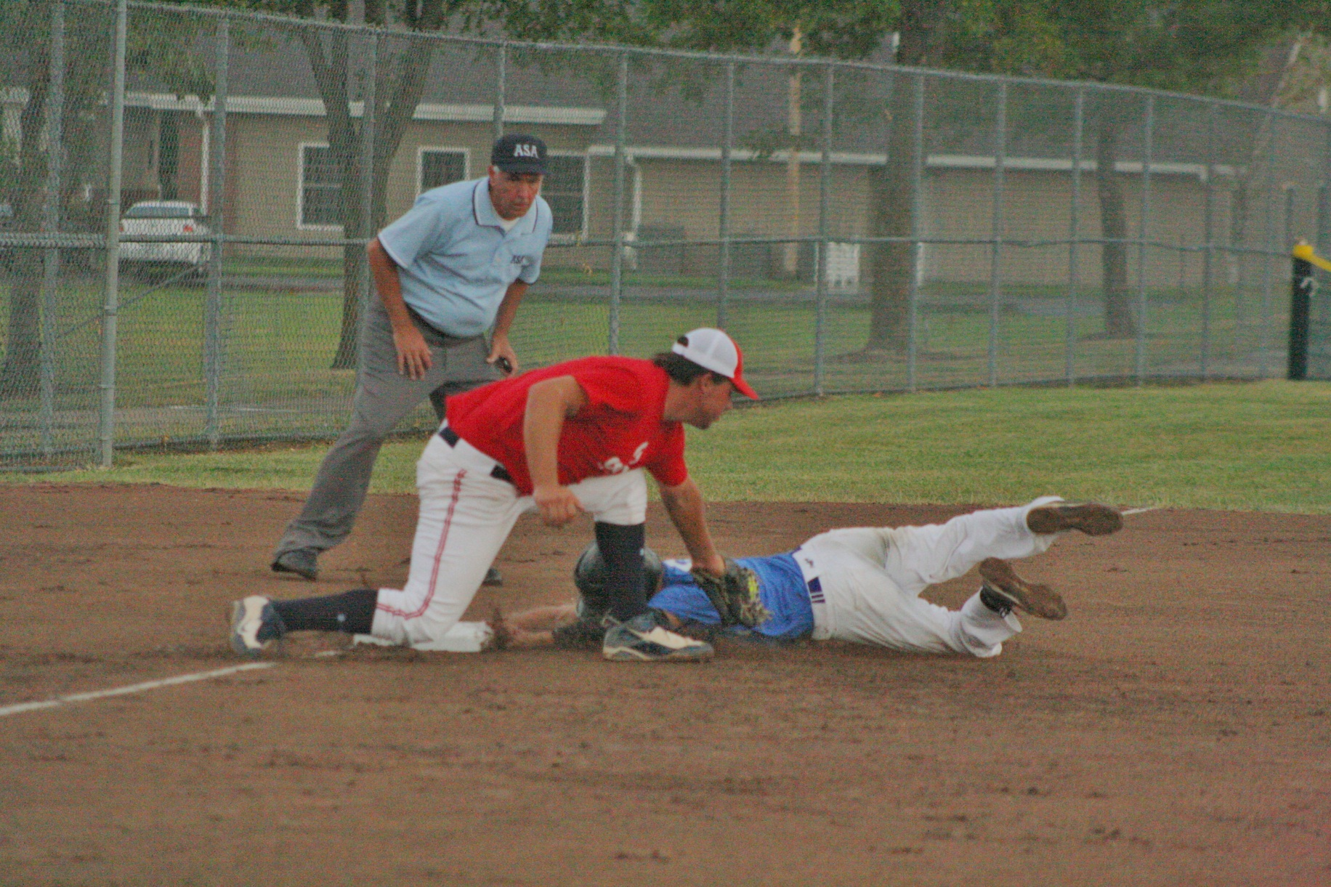
Stop, Read the Play,
GET AN UNOBSTRUCTED VIEW
Make the Call

Slide 41
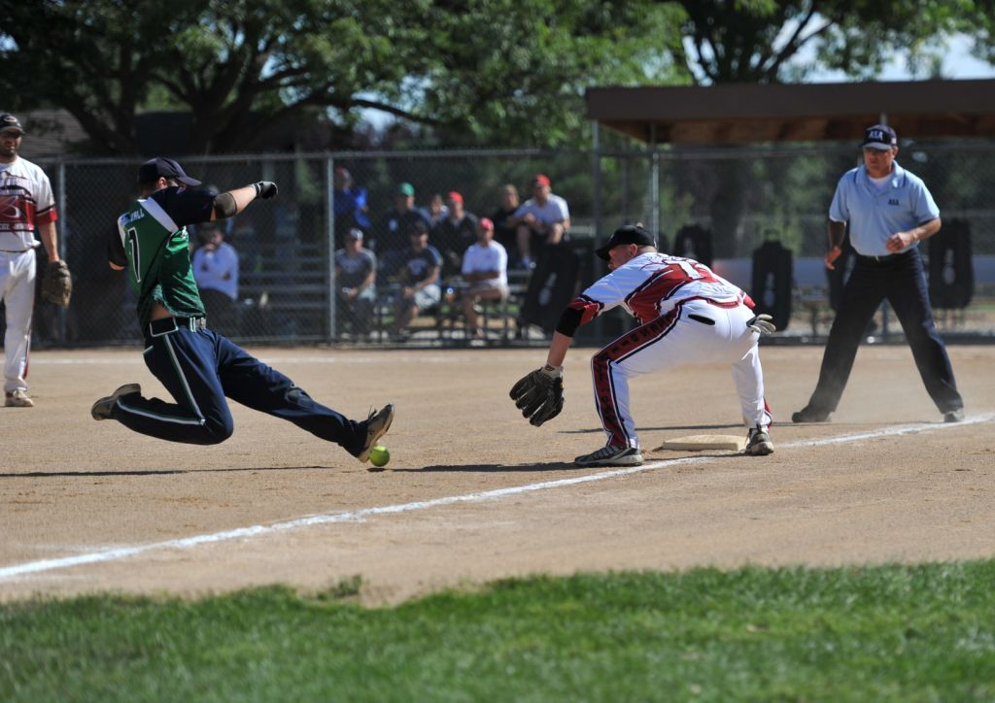
Stop, Read the Play,
GET AN UNOBSTRUCTED VIEW
Make the Call

Slide 42
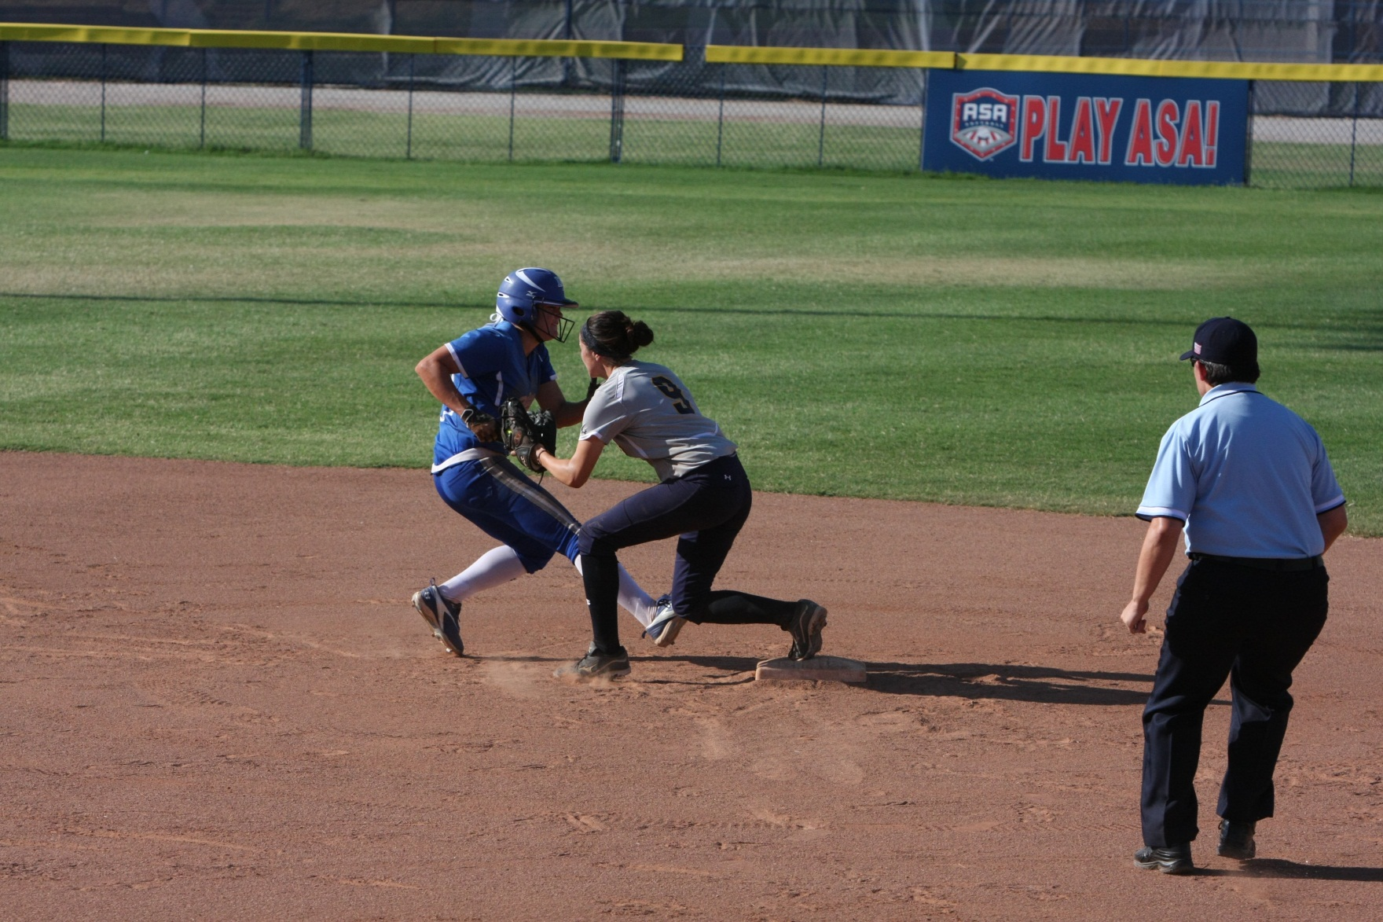
Stop, Read the Play,
GET AN UNOBSTRUCTED VIEW
Make the Call

Slide 43
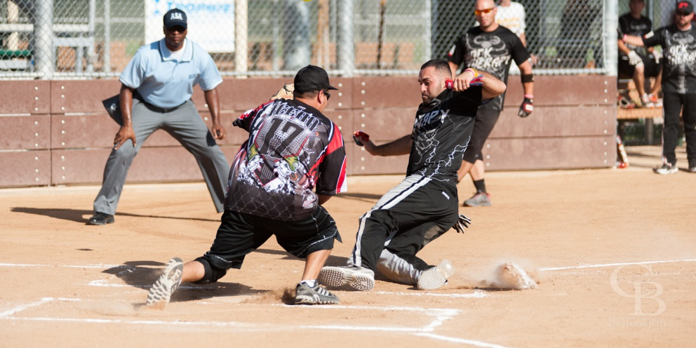
Stop, Read the Play,
GET AN UNOBSTRUCTED VIEW
Make the Call

Slide 44
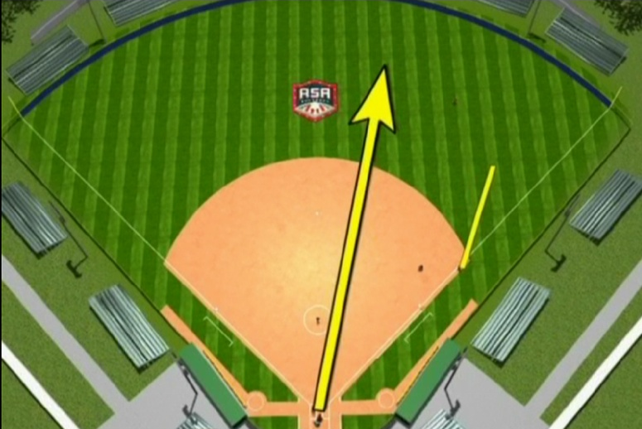
FLY BALL COVERAGE
Movement
  Parallel to the flight of the ball
  Stop, read the play, make the call
  Stay outside
Let the ball turn you back to the infield to observe additional plays
Notes:
Outfield Coverage – When/Routing/Get Set

Slide 45
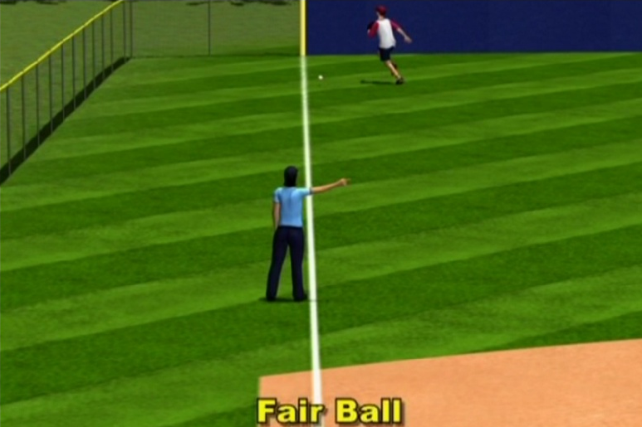
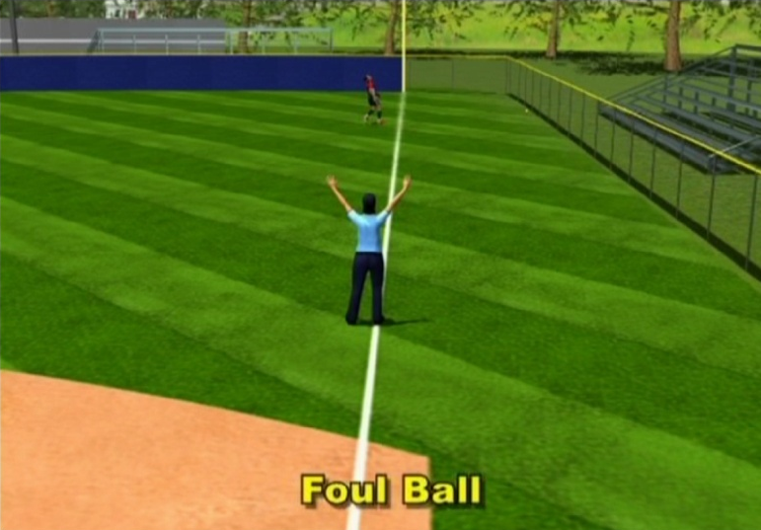
FLY BALL COVERAGE
Fair Ball near line
  Stay near line
  When ball becomes fair, point fair - no verbal
Foul ball near line
  Stay near the line
  Use Dead Ball signal followed by verbal
  No point necessary?

Slide 46
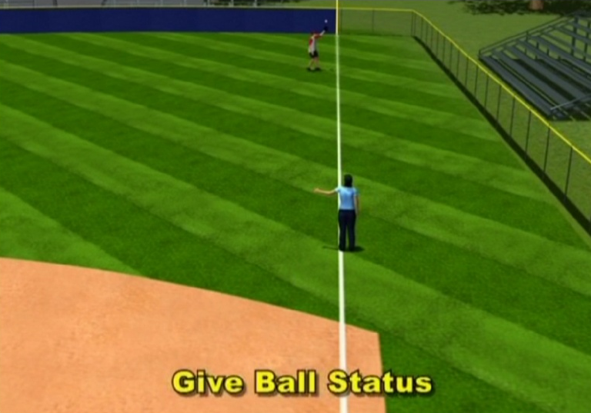
FLY BALL COVERAGE
Fly ball near line
  Give status
    When first touched
    Point fair when fair
    Point foul when foul
  After status
    Out signal if caught
    Strong dead ball if foul
    Strong fair ball signal

Slide 47
Game Administration
Dusting Bases and Pitcher’s Plate
Indicator – Glance
Signals – Clear and Concise
Sell Calls – Illegal Pitches, Interference, Obstruction
Infield Fly Signal – Who Calls?
Watch the Ball, Always Eyes on the Ball
Returning to Position

Slide 48
BASE MECHANICS
The keys to effective Base Mechanics are:
  Proper Starting Position
  Proper Movement
  Proper Angles
  Proper Distance
  Proper Timing
  How do YOU stack up?

Slide 49
Angles and Distances

Slide 50
What is a good angle?
Notes:
We know that we must always work to get the best angle on all plays, but just what does that mean? A good angle is as important as obtaining the proper distance to the play.

Slide 51
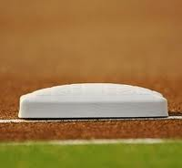


What is a good angle?
Where you keep all four elements in front of you
  Ball
  Base
  Offense
  Defense
Notes:
Umpires must hustle to get into the correct position with proper angle and distance to see the ball, the base, the runner and the fielder come together before making a call.

Slide 52
More than just having these elements in front of you
Force Outs
  Defense controlling ball
  Defense contacting base
  Offense contacting base
Tag Plays
  Defense contacting offense with ball
  Defense maintaining control of ball
  Offense contacting base
Notes:
With the proper angle and distance achieved we must focus on the interaction of the four elements.
Force Outs: Defense controlling the ball - Defense contacting base and the Offense contacting base
Tag Plays: Defense contacting offense with the ball-Defense maintaining control of the ball and the Offense maintaining contact with the base

Slide 53
Seeing the Interactions of the Four Elements While Moving to Position
Watch the fielder field the ball
Move parallel to the baseline keeping proper distance from the play
Let the ball turn your head, taking you to the play as you square up….
STOP, SEE the play, THEN make the call

Slide 54
Distance and Primary Viewing Angle

Slide 55
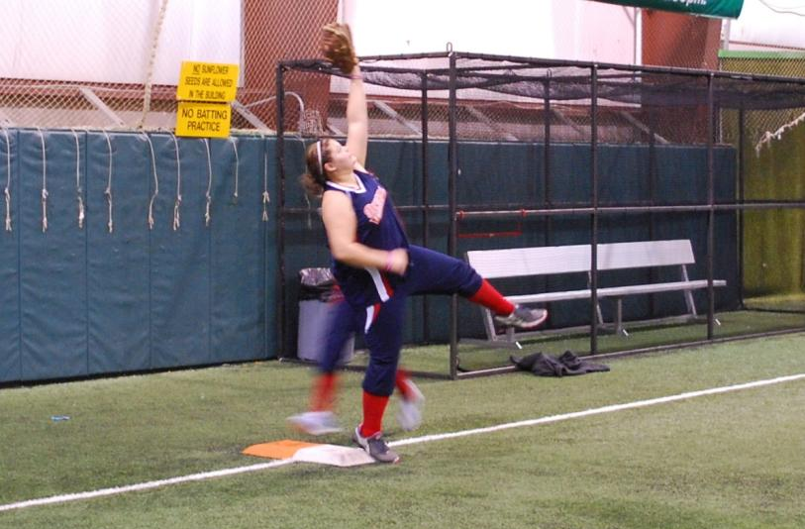
5’5” Player-7’8” Reach
12’ From the Play
Notes:
When focusing on the base from 12’ away you can not see the glove and ball within your primary viewing area (30 degrees from your line of sight) without shifting your eyes up to the glove.

Slide 56

5’5” Player-7’ 8” Reach
15’ From the Play
Notes:
From 15’ away you can see that only the edges are outside the primary viewing area and you can see both the feet and the glove within the primary viewing area. However, remember this is only a 5’ 5” player. Also remember that the closer all the information is to the line of sight, the better your ability to see it clearly (refer back to green vs yellow circle on slide 23).

Slide 57
5’ 5” Player-7’ 8” Reach
18’ From the Play
Notes:
At 18’ everything is well within the primary viewing area to allow you to process all information at once without having to shift your eyes from base to glove.

Slide 58
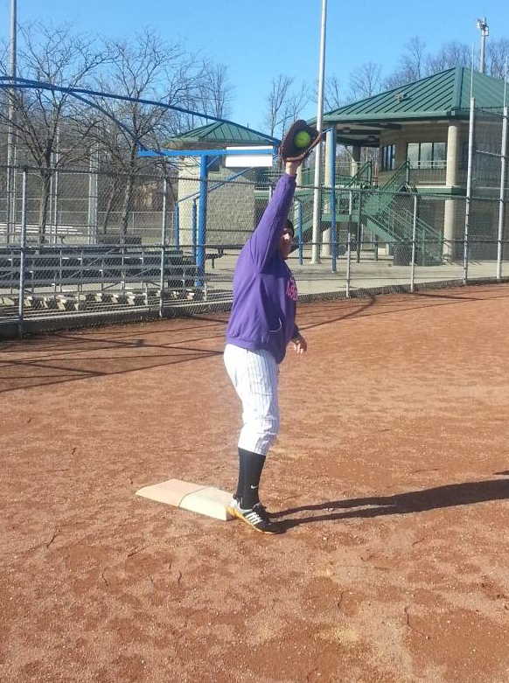
6’ 2” Player
10’1” Reach
12’ From the Play
Notes:
When focusing on the base from 12’ away you can not see the glove and ball within your primary viewing area (30 degrees from your line of sight) without shifting your eyes up to the glove.

Slide 59
6’ 2” Player
10’1” Reach
15’ From the Play
Notes:
When focusing on the base from 15’ away you can not see the glove and ball within your primary viewing area (30 degrees from your line of sight) without shifting your eyes up to the glove.

Slide 60
6’ 2” Player
10’ 1” Reach
18’ From the Play
Notes:
At 18’ everything is within the primary viewing area to allow you to process all information at once without having to shift your eyes from base to glove. But as a thinking umpire be ready to possibly move back based on taller players.

Slide 61
Primary Positioning
Notes:
Force plays, tag plays and plays at first require that we achieve the proper position so that we may view the entire play. This is our primary position.

Slide 62
What is a primary position?
Initial location used by an umpire to rule on a play as the base runner approaches a base or as a play develops.
Primary positions are determined by the prospect of a traditional play.
The umpire’s line of vision forms a 90-degree angle perpendicular to:
    The path of the base runner on a tag into the base.
    The application of a tag on a tag play not involving a base.
    The path of the flight of the ball on force play.

Slide 63

Force outs and Plays at 1B
90 degrees from the throw
15’-18’ feet on a force
No further than a 45º angle from the foul line at 1B
Notes:
Keep in mind that on plays at first we should let the ball turn our head into the play maintaining an angle that is 90 degrees from the throw and no further than 45 degrees from the foul line.

Slide 64
Tag Plays
Primary Position:
  90 degrees to the path of the runner
  6’-10’ from the base they are trying to reach
Secondary Position:
  Move as necessary to get an unobstructed view of the play
  Best angle is 90 degrees to the tag
    This allows you to see thru the tag
Notes:
It may be necessary to adjust from the primary position to get the best unobstructed view of the play. This is achieved with the proper angle and distance, that will allow you to see between the offense and defense, WHILE keeping the four elements in front of us and letting the ball turn us into the play.

Slide 65
Visual indicators for alignment at 1B

Slide 66
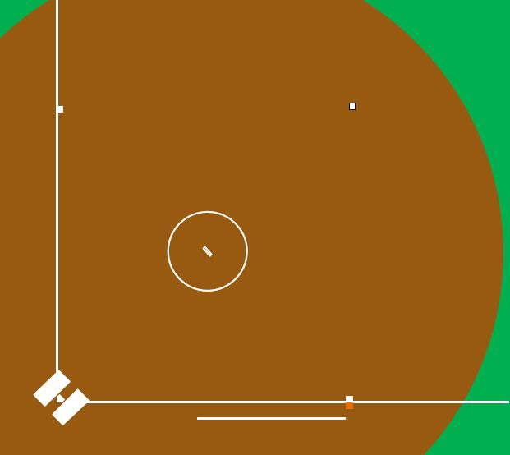
90 degrees to the throw
Notes:
As ball is fielded by short stop F3 moves into position to accept throw which places F3’s shoulders (before the stretch) at 90 degrees to the throw.

Slide 67
Helpful Hints for Proper Angle at 1B
What is a 45 degree angle from 1B line?
  The front outside corner to the back inside corner of the white portion of 1B makes a 45 degree angle.

Slide 68
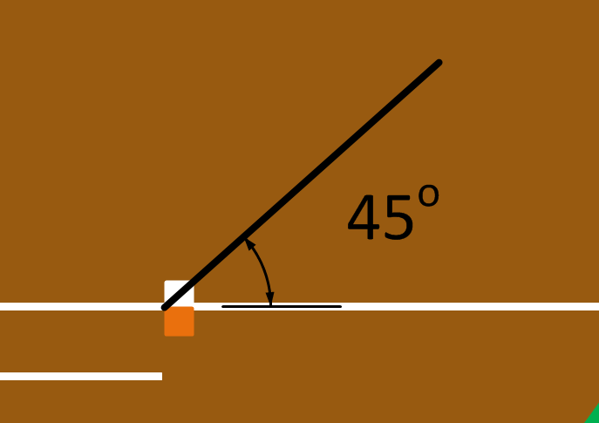

45 Degree Angle at 1B

Slide 69
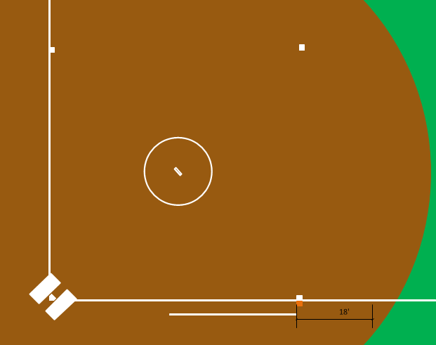
Guideline to keep proper depth
Notes:
Visual of moving along this imaginary line.

Slide 70
Plays at 1B

Slide 71
Throw from 2B
Distance from Base | Distance from starting Position | Steps into field
18 Feet | 3’ | 1 Steps
Notes:
Pushing off the left foot, move to a 90 degree angle from the throw. The black rectangle on the slide represents where the umpire pushed off with their left foot. The reference of 31” stride is an average and used to calculate number of steps in the following slides, actual steps will vary with individual umpire. We are NOT trying to have umpires count their steps every play, but this is a tool to help get them to the proper positions.

Slide 72
Throw from Short Stop Area
Distance from Base | Distance from starting Position | Steps into field
18’ | 8’ 10” | 2-2.5 Steps
Notes:
Showing a throw from short stop with proper position and distance both from the base as well as from the starting point in foul ground. Steps into the field will vary with each umpires stride. This is not an exact step count

Slide 73
Throw From 3B Area
Distance from Base | Distance from starting Position | Steps into field
20’ | 15’ 5” | 3 Steps
Notes:
View of throw from 3B with proper position. Any ball thrown from within the red triangle area, the umpire would stop at a 45 degree angle from the foul line. This allows the best view of the play while giving the umpire the ability to move back to the foul line for a swipe tag if F3 is pulled off 1B by the throw.

Slide 74
Tag Plays

Slide 75
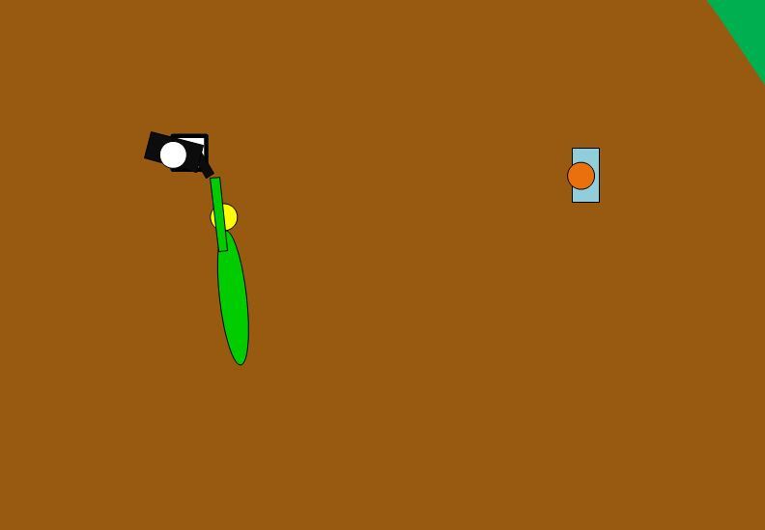

Steal at 2B
Notes:
Overview to show the angle on tag, followed by a close up view of the play. Notice the umpire is 90 degrees from the tag looking through the offense and defense.

Slide 76
Views from
Different Angles

Slide 77


Throw from 3B
B
A
Notes:
Camera A shows the throw from 3B to 1B, umpire just one step off the line into the field.
Camera B is the same play but umpire comes off the line to a 90 degree angle with the throw AND NO MORE THAN a 45 degree angle with the foul line.
Notice the difference in what the umpire can see. Defensive player’s foot on the bag.

Slide 78

Throw from Short Stop,
F3 pulled off bag for tag
A
B
C
Notes:
Camera A is an umpire that has gone past 45 degrees to the line
Camera B is at 45 degrees
Camera C is view from where umpire adjusts as play develops into a tag play

Slide 79



Tag at 1B
B
C
A
Notes:
Camera A is set up at a 70 degree angle from foul line with the base umpire moving closer to home to view the tag.
Camera B is set up is set up at a 45 degree angle of the foul line if fair territory, this is an umpire that moves to primary position and does NOT adjust for the tag play.
Camera C is set up with the umpire moving back to the foul line to look THROUGH THE TAG.

Slide 80
Views on throws from 2B
B
C
A
Notes:
Camera A is an umpire that went to foul ground for the play
Camera B is an umpire that defaulted to the 45 degree angle
Camera C is just across the foul line, 90 degrees to the throw

Slide 81



Throw from 2B
A
B
C
Notes:
Camera A set up at a 45 degree angle from foul line in foul territory. Notice the blocked view of the defensive player
Camera B is set up at a 45 degree view from the foul line in fair territory
Camera C is set up with a 90 degree angle of the throw from second base. Notice the pulled foot. We are not debating if you would call that or not, just showing the additional information available when 90 degrees to the throw.

Slide 82

Throw From Short Stop Area
Notes:
This was a Dodgers Rockies Game this past season. This umpire called the runner OUT. Red line shows where his line of sight is to the play. He can’t see the bag in this position.

Slide 83




Throw from short stop area
Notes:
Red line shows what his line of sight would have been if he had moved to a 90 degree angle to the throw and no more than a 45 degrees from the line.

Slide 84
Views on Pickoff at 2B
B
A
Notes:
This is a 3 umpire system, with U1 starting counter rotated.
Camera A is the umpire that moves straight in
Camera B is the umpire that moves to a position to be 90 degree with the tag looking through offense and defense

Slide 85


Pickoff at 2B
A
B
Notes:
Camera A is where an umpire comes straight into the infield to see the pick-off.
Camera B is where the umpire moves to look through the pick-off

Slide 86
Angles and Distance
  Difficult situations:
  Fielders blocking view
  Over throw at a base
  When do you to move to a secondary position:
  The next position assumed by the umpire AFTER the initial plays continuous action.

Slide 87
2 Umpire
System

Slide 88

TWO UMPIRE SYSTEM
No Runners on Base - Fast Pitch
PLATE UMPIRE:
1. On infield, ground hits close to foul line, stay at home plate and make the call.
2. On infield hits, move up the first base line observing the play, and be prepared to help your partner.
FIELD UMPIRE:
1. Basic position is 18 to 21 feet beyond first base in foul territory.
2. Responsible for batter-runner into third-base.

Slide 89

2 UMPIRE SYSTEM - 1rst B
Runner on First Base Only - Fast Pitch
Plate Umpire:
1. On batted balls to the infield leave to the left of the catcher moving up first base line to observe the play, then fade toward third base to cover the advancing runner.
2. On steals where there is a wild throw at second base, pick up the runner advancing to third base, and be prepared to take the runner home.

Slide 90
2 UMPIRE SYSTEM - 1rst B
Runner on First Base Only - Fast Pitch
Field Umpire:
1. Take a position about halfway between first and second base and outside the base line. This position will normally place the umpire two or three steps behind and to the left side of the second baseman.
2. If the runner attempts to steal second, move toward the base staying behind the fielder. Should the throw be wild, move inside the base paths.
3. On base hits to the outfield, immediately come inside the diamond, buttonhook and take the batter-runner all the way to third base.
4. On a double play, take two steps toward second base, follow the flight of the ball and move toward first base as the ball takes you into the play.
5. Has tag responsibility for runner at first base, and takes single runner all the way to third base after the catch.

Slide 91

2 UMPIRE SYSTEM - 2nd B
Runner on Second Base Only - Fast Pitch
PLATE UMPIRE:
1. On hits, move toward third base. Be ready and in position to make a call by going down the left field foul line in foul ground. When about 15 feet from third base, quickly move into the infield for good position for the call.
2. If the first play is at first base, and there is a throw to third, the plate umpire has the call at third.

Slide 92
2 UMPIRE SYSTEM - 2nd B
Runner on Second Base Only - Fast Pitch
Field Umpire:
1. Take a position two or three steps behind and to the left of the shortstop. Be cautious so as not to interfere with the outfielders' view of the batter or play by the infielders.
2. On any ball hit to the infield, take the first throw unless it is to home plate. If the first throw is to first or second base, any subsequent throw to third base is covered by the plate umpire.
3. On all balls hit through the infield or to the outfield that you do not go out on, immediately come inside the diamond, buttonhook and take the batter-runner all the way to third base.
4. On routine fly balls to the outfield, move into infield to a position between the pitching rubber and base line. You are responsible for the tag-up of the runner, and after the ball is caught, follow the runner into third base.
5. See that the batter-runner touches first and second base. When the ball is in the outfield, take a position deep enough in the infield to allow movement for a play at either base.
6. On an attempted steal of third, move toward third base and be prepared for a call.

Slide 93

2 UMPIRE SYSTEM - 3rd B
Runner on Third Base Only - Fast Pitch
PLATE UMPIRE:
1. If a fly ball is hit, get out from behind home plate and line up the runner on third base and watch the tag-up.
2. On base hits, move toward third base, watching the runner. If the runner goes home, drift back toward home plate and watch the runner touch the plate.
3. Refer to the PLATE UMPIRE SECTION.

Slide 94
2 UMPIRE SYSTEM - 3rd B
Runner on Third Base Only - Fast Pitch
Field Umpire:
1. Take a position two or three steps behind and to the right of the shortstop. Be cautious so as not to interfere with the outfielders' view of the batter or play by the infielders.
2. If a ball is hit to the infield, wait until the fielder commits himself, then move quickly toward that base. Don't take your eyes off the ball.
3. Call all plays made on the first throw of the ball unless it is to home plate. Take the batter-runner into third base and see that all bases are touched.

Slide 95

2 UMPIRE SYSTEM - 1st & 2nd B
Runner on First and Second Base - Fast Pitch
PLATE UMPIRE:
1. On base hits take lead runner into third base and home. On steals where there is a wild throw at second base pick up the runner coming into third base.
2. Be ready and in position to make a call at third base by going down the left field foul line in foul ground. When you are about 15 feet from third base quickly move into the infield for good position on the tag play.
3. On hits, move toward third base. If the lead runner comes home and there is no play made on him, drift toward third but watch the runner touch home plate.
4. Responsible for tag at second base.

Slide 96
2 UMPIRE SYSTEM - 1st & 2nd B
Runner on First and Second Base - Fast Pitch
Field Umpire:
1. Take a position two or three steps behind and to the left of the shortstop. Be cautious so as not to interfere with the outfielders view of the batter or play by the infielders.
2. On any ball hit to the infield, take the first throw unless it is to home plate. If the first throw is to first or second base, any subsequent throw to third base is covered by the plate umpire.
3. If the runner attempts to steal third, move toward the base to make the call.
4. On routine fly balls to outfield, move into infield to a position between pitching rubber and base line. You are responsible for the tag-up of the runner on first.
5. See that the runner and batter touch second and first base. When the ball is in the outfield, take a position deep enough in the infield to allow you to move in for a play at either base.

Slide 97

2 UMPIRE SYSTEM - 1st & 3rd B
Runner on First and Third Base - Fast Pitch
PLATE UMPIRE:
1. If a fly ball is hit, get out from behind home plate and line up the runner on third base and watch the tag-up.
2. On base hits, move toward third base. If the lead runner comes home and there is no play made on him, drift toward third but watch the runner touch home plate. If there is a play at home, move back to a position in the rear and left side of the right-handed batter's box.
3. If the play is at first base, watch the lead runner touch home plate, then go to third for a possible play on the second runner.

Slide 98
2 UMPIRE SYSTEM - 1st & 3rd B
Runner on First and Third Base - Fast Pitch
Field Umpire:
1. Take a position two or three steps behind and to the right of the shortstop. Be careful not to interfere with the outfielder's view of the batter or play by the infielders.
2. On any ball hit to the infield, take the first base unless it is to home plate. If the first throw is to first or second base, any subsequent throw to third base is covered by the plate umpire.
3. If a ball is hit to the infield wait until the fielder commits himself, then move quickly toward that base. Don't take your eyes off the ball.
4. On any ball hit to the infield, take the first throw unless it is to home plate. If the first throw is to first or second base, any subsequent throw to the third base is covered by the plate umpire.
5. On a base hit, get inside the infield quickly and watch the runner on first touch second base and be alert for a play at that base, take the batter-runner as far as third base and watch him touch each base.
6. On fly balls, get inside the infield quickly, buttonhook and line up the runner on first base. After checking the runner tag-up at first base, be prepared to take him into second and/or third base.

Slide 99

2 UMPIRE SYSTEM - 2nd & 3rd B
Runner on Second and Third Base - Fast Pitch
PLATE UMPIRE:
1. If a fly ball is hit, line up the runner on third base and watch the tag-up.
2. On base hits, move toward third base. If the lead runner comes home and there is no play on him, drift toward third but watch the runner touch home plate. If there is a play at home, move back to a position in the rear and left side of the right-handed batter's box.
3. If the play is at first base, watch the lead runner touch home plate, then go to third for a possible play on the second runner.

Slide 100
2 UMPIRE SYSTEM - 2nd & 3rd B
Runner on Second and Third Base - Fast Pitch
Field Umpire:
1. Take a position two or three steps behind and to the right of the shortstop. Be careful not to interfere with the outfielders view of the batter or the play by the infielders.
2. On any ball hit to the infield, take the first throw unless it is to home plate. If the first throw is to first or second base, any subsequent throw to third base is covered by the plate umpire.
3. On fly balls, get inside the infield quickly, button hook and line up the runner on second base and take the runner to third base after the catch.
4. On all balls hit through the infield or to the outfield that you do not go out on, immediately come inside the diamond, button hook and take the batter-runner all the way to third base.

Slide 101

2 UMPIRE SYSTEM - Bases Loaded
Bases Loaded - Fast Pitch
PLATE UMPIRE:
1. If a fly ball is hit, get out from behind home plate and line up the runner on third base and watch the tag-up.
2. On base hits move toward third base in foul territory. If the lead runner comes home and there is no play made on him, drift toward third but watch the runner touch home plate. If there is a play at home, move back to a position at the rear and left side of the right-handed batter's box.
3. If the play is at first base, watch the lead runner touch home plate, then go to third for a possible play on the second runner.
4. Refer to PLATE UMPIRE SECTION.

Slide 102
2 UMPIRE SYSTEM - Bases Loaded
Bases Loaded - Fast Pitch
Field Umpire:
1. Take a position two or three steps behind and to the right for the shortstop. Be careful not to interfere with the outfielder's view of the batter or play by the infielders
2. On any ball hit to the infield, take the first throw unless it is to home plate. If the first throw is to first or second base, any subsequent throw to third base is covered by the plate umpire.
3. If a ball is hit to the infield wait until the fielder himself, then move quickly toward third base. Don't take your eyes off the ball.
4. On any ball hit to the outfield, get inside the diamond, buttonhook and be prepared to make a call at first, second or third base.
5. On fly balls, move inside the diamond quickly to take tag-ups of runners on first and second base, and be prepared for any play into second base.

Slide 103
QUESTIONS?

Slide 104

Special Thank You!

