Slide 1


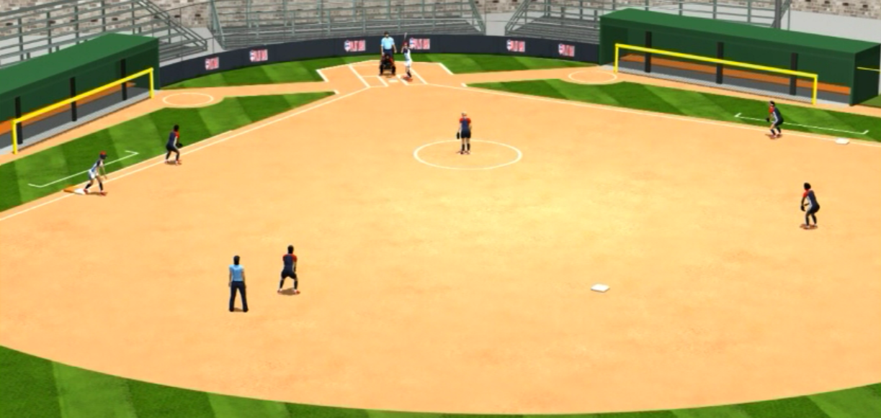
TWO UMPIRE
BASE MECHANICS

Slide 2
No Runners On
Hit to Infield
Base Umpire:
When the ball is hit, step into fair
territory at an angle 90 degrees
to the path of throw but not more than 45 degrees from the foul line.
FAST PITCH
Base Umpire:
Stand upright
in a relaxed
position
18-21 feet
beyond first
base in foul
territory.
Take one or two
steps with the
pitch.
Plate Umpire: Trail the batter-runner about 1/3 of the way to 1B staying close to the foul line, unless the play takes you elsewhere

Slide 3
No Runners On
Double
Base Umpire:
Move inside the diamond 10-12’ from the line, button-hook and follow the runner
FAST PITCH
Base Umpire:
Stand upright
in a relaxed
position
18-21 feet
beyond first
base in foul
territory.
Take one or two
steps with the
pitch.
Plate Umpire: Trail the batter-runner about 1/3 of the way to 1B staying close to the foul line unless the ball takes you elsewhere, then transition to the holding zone

Slide 4
Runners On 1B
Base Hit
Base Umpire:
Start behind and
off the 1B
side of F4, shade lead runner, square to plate, go to ready
position at
start of pitch
FAST PITCH
Base Umpire:
Button-hook 10-12’ inside the diamond, letting the ball take you to the play
Plate Umpire: Trail the batter-runner, transition to holding zone, be prepared for a play on the lead runner at 3B and any play at the plate

Slide 5
Runners On 1B
Double Play
Base Umpire:
Start behind and
off the 1B
side of F4, shade lead runner, square to plate, go to ready
position at
start of pitch
FAST PITCH
Base Umpire:
When play goes to 2B, take 1 or 2 steps parallel toward 2B, push off right foot and make the call while moving parallel to baseline toward 1B without taking eyes off ball, allow the ball to turn your head
Plate Umpire: Trail the batter-runner

Slide 6
Runners On 2B
Hit to Infield
Base Umpire:
Start behind and
off the 2B
side of F6, shade lead runner, square to plate, go to ready
position at
start of pitch
FAST PITCH
Base Umpire:
Read the play and get the best angle and distance possible
Plate Umpire: Move to holding zone, be prepared for a play on a subsequent throw to 3B and any play at the plate

Slide 7
Runners On
1B & 2B
Hit to Infield
FAST PITCH
Base Umpire:
Start behind and
off the 2B
side of F6, shade lead runner, square to plate, go to ready
position at
start of pitch
Base Umpire:
Read the play and get the best angle and distance possible
Plate Umpire: Move to holding zone, be prepared for a play on a subsequent throw to 3B and any play at the plate

Slide 8
Runners On
1B & 2B
Hit to Infield
FAST PITCH
Base Umpire:
Start behind and
off the 2B
side of F6, shade lead runner, square to plate, go to ready
position at
start of pitch
Base Umpire:
Read the play and get the best angle and distance possible
Plate Umpire: Move to holding zone, be prepared for a play on a subsequent throw to 3B and any play at the plate

Slide 9
Bases Loaded
Hit to Infield
FAST PITCH
Base Umpire:
Start behind and
off the 3B
side of F6, shade lead runner, square to plate, go to ready
position at
start of pitch
Base Umpire:
Read the play and get the best angle and distance possible
Plate Umpire: Move to holding zone, be prepared for a play on a subsequent throw to 3B and any play at the plate

Slide 10
Bases Loaded
Base Hit to
Outfield
FAST PITCH
Base Umpire:
Start behind and
off the 3B
side of F6, shade lead runner, square to plate, go to ready
position at
start of pitch
Base Umpire:
Button hook inside the diamond about ½ way between 1B & 2B, pick up the ball and glance at the runner
Plate Umpire: Move to holding zone, be prepared for a play on a lead runner at 3B and any play at the plate

